Slide 1
Grammar & Mechanics Monday
Introduction to Rhetorical Terminology

Slide 2
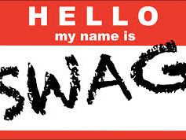
Got swag?
Think of your writing—and especially your writing style—as your rhetorical swag.

Slide 3
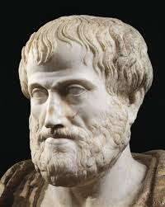
Rhetoric
Rhetoric, you say? What is rhetoric?
“The faculty of observing, in any given case, the available means of persuasion.”
– Aristotle

Slide 4
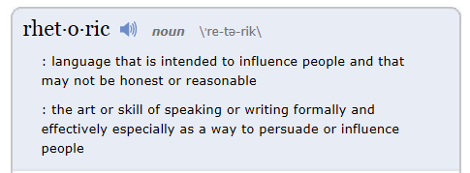
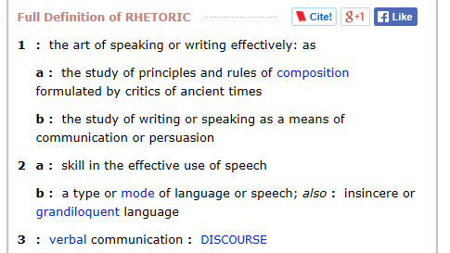
Rhetoric

Slide 5
Rhetoric
Rhetoric: the art of effective communication—especially persuasive discourse
Rhetorical situation: as the context of a rhetorical event, the rhetorical situation consists of an issue, an audience, and a set of constraints
The “situation” which generates the need for writing is affected by the
Time period or timing
Location
Current events
Cultural significance

Slide 6
Rhetorical Situation
You need to be aware of the rhetorical situation every time you write, and you should adapt your writing depending on your purpose and audience.
Writer
Purpose
Audience
Topic
Context
Culture

Slide 7
Rhetorical Triangle
Aristotle believed that from the world around them, speakers could observe how communication happens and use that understanding to develop sound and convincing arguments. In order to do that, speakers needed to look at three elements, graphically represented by what we now call the rhetorical triangle:
Message
Audience
Speaker

Slide 8
Rhetorical Triangle
Aristotle said that when a rhetor or speaker begins to consider how to compose a speech— that is, begins the process of invention—the speaker must take into account three elements: the message, the audience, and the speaker. The three elements are connected and interdependent; hence, the triangle.
Message
Audience
Speaker

Slide 9
Speaker
The use of experience and observation brings Aristotle to the speaker point of the triangle. Writers use who they are, what they know and feel, and what they’ve seen and done to find their attitudes toward a subject and their understanding of a reader.
Your cultural background, personal characteristics, and interests will affect what you write about and how you write it.
Influences include: age, experiences, gender, location, political beliefs, parents and peers, education, etc.

Slide 10
Message
Considering the message means that the writer/speaker evaluates what he or she knows already and needs to know, investigates perspectives, and determines kinds of evidence or proofs that seem most useful.
The message or topic should be appropriate to the rhetorical situation

Slide 11
Audience
Considering the audience means speculating about the reader’s expectations, knowledge, and disposition with regard to the subject writers explore.
For example, a writer might consider the audience’s
Age
Social class
Education
Past experiences
Culture/subculture
Expectations

Slide 12
Rhetorical Components
Aristotle taught that a speaker’s ability to persuade an audience is based on how well the speaker appeals to that audience in five different areas: logos, ethos, pathos, telos, and kairos.

Slide 13
Logos
Logos is frequently translated as some variation of “logic or reasoning,” but it originally referred to the actual content of a speech and how it was organized. Today, many people may discuss the logos qualities of a text to refer to how strong the logic or reasoning of the text is. But logos more closely refers to the structure and content of the text itself. In this resource, logos means “text.”

Slide 14
Ethos
Ethos is frequently translated as some variation of “credibility or trustworthiness,” but it originally referred to the elements of a speech that reflected on the particular character of the speaker or the speech’s author. Today, many people may discuss ethos qualities of a text to refer to how well authors portray themselves. But ethos more closely refers to an author’s perspective more generally. In this resource, ethos means “author.”

Slide 15
Pathos
Pathos is frequently translated as some variation of “emotional appeal,” but it originally referred to the elements of a speech that appealed to any of an audience’s sensibilities. Today, many people may discuss the pathos qualities of a text to refer to how well an author appeals to an audience’s emotions. Pathos as “emotion” is often contrasted with logos as “reason.” But this is a limited understanding of both pathos and logos; pathos more closely refers to an audience’s perspective more generally. In this resource, pathos means “audience.”

Slide 16
Telos
Telos is a term Aristotle used to explain the particular purpose or attitude of a speech. Not many people use this term today in reference to rhetorical situations; nonetheless, it is instructive to know that early rhetorical thinkers like Aristotle actually placed much emphasis on speakers having a clear telos. But audiences can also have purposes of their own that differ from a speaker’s purpose. In this resource, telos means “purpose.”

Slide 17
Kairos
Kairos is a term that refers to the elements of a speech that acknowledge and draw support from the particular setting, time, and place that a speech occurs. Though not as commonly known as logos, ethos, and pathos, the term kairos has been receiving wider renewed attention among teachers of composition since the mid-1980s. Although kairos may be well known among writing instructors, the term “setting” more succinctly and clearly identifies this concept for contemporary readers. In this resource, kairos means “setting.”

Slide 18
Purpose
entertain
Why are you writing?
Author’s purpose
call to action
persuade
educate
inform
describe

Slide 19
Style
A writer’s style is what distinguishes his or her writing and makes it unique.
Style may be adapted to fix the specific context, purpose or audience.
Elements such as such as word choice, sentence fluency, and the writer’s voice all contribute to style.

Slide 20
Tone
In writing, tone can refer to: a writer’s style, character, or attitudes. As a reader, you will get certain feelings from a writer’s attitude toward certain topics. For example, if a writer expresses his or her passion in some topics, then the tone of the writing will very excited. A writer’s tone can be different from genre to genre, and from topic to topic. A Writer’s tone can be formal, informal, subjective, objective, critical, etc.

Slide 21
Word Choice
Good writers pay careful attention to word choice, selecting the most concise and precise words to convey their exact meaning.
Precise words—active verbs, concrete nouns, specific and vivid adjectives—help engage the reader.
Good writers use adjectives sparingly and adverbs rarely because they let their nouns and verbs do the work.

Slide 22
Diction
Diction is a writer’s word choice.
High or Formal Diction usually contains language that creates and elevated tone. It is free of slang, idioms, colloquialisms, and contractions. It often contains polysyllabic words, sophisticated syntax, and elegant word choice.
Neutral Diction uses standard language and vocabulary without elaborate words and may include contractions.
Informal or Low Diction is the language of everyday use. It is relaxed and conversational. It often includes common and simple words, idioms, slang, jargon and contractions.

Slide 23
Denotation & Connotation
Denotation is the exact, literal definition of a word independent of any emotional association or secondary meaning.
Connotation is the implicit rather than explicit meaning of a word and consists of the suggestions, associations, and emotional overtones attached to a word.

Slide 24
Sentence Fluency
Sentence fluency refers to the flow and rhythm of phrases and sentences.
Good writers use a variety of sentences with different lengths and rhythms to achieve different effects.

Slide 25
Voice
Voice reveals the author’s personality.
For example, a writer’s voice can be impersonal or chatty, authoritative or reflective, objective or passionate, serious or funny.

Slide 26
Rhetoric
Subject
Logos
Tone
Style
Ethos
Pathos
Speaker
Purpose
Audience

Slide 27
Application
Who is Tony Stewart?
What kind of reputation does he have?
Viewer discretion advised: https://www.youtube.com/watch?v=qILmIyG6qno

Slide 28
Application
Using your knowledge of rhetoric, analyze the following statement Tony Stewart released regarding the fatal accident at Canandaigua (N.Y.) Motorsports Park involving Kevin Ward Jr.:
“There aren’t words to describe the sadness I feel about the accident that took the life of Kevin Ward Jr. It’s a very emotional time for all involved, and it is the reason I’ve decided not to participate in today’s race at Watkins Glen. My thoughts and prayers are with his family, friends and everyone affected by this tragedy.”

